Slide 1
Crop Protection from Animals
Team Neural Networks
Anushka Shukla
Prashant Maikhuri
Tharani Kumar
Vishwa Hatwalne

Slide 2
Need for Crop Protection
Traditional methods of crop protection against animals are sub-par and might even pose a danger to the crops in some cases.
Agriculture is one of the primary sources of employment for the people of India and contributes to 17% of India’s GDP.
Other pre-existing methods include putting up electric fences or spikes, which cause harm to the animals in the region.
India suffers huge amounts of crop losses evey year, owing to weather conditions, pest infestations, plant diseases and animal attacks.
Manual surveillance and protection of crops by farmers is nearly impossible, owing to the vast areas and time required to do that
The losses suffered due to animal intrusions are caused by wild and local animals, whether it may be from animals eating the crops, stampeding them or uprooting them.

Slide 3
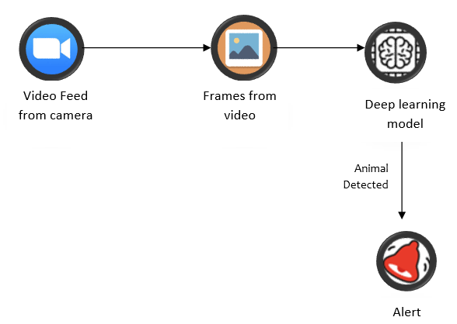
Proposed System
We have proposed a system which includes 24/7 surveillance of the crops and farmlands via cameras installed in the area. The content captured by the cameras will be set up to be live streamed to a web application.
The web application would process each frame of the incoming video stream and work to detect any animals that may be intruding on the lands.
If an animal were to be detected, a loud alarm sound would be played, thus alerting the farmer to the situation and startling the approaching animals. This ensures the safety of the crops and helps in avoiding or at the very least, minimizing damage to the crops.

Slide 4
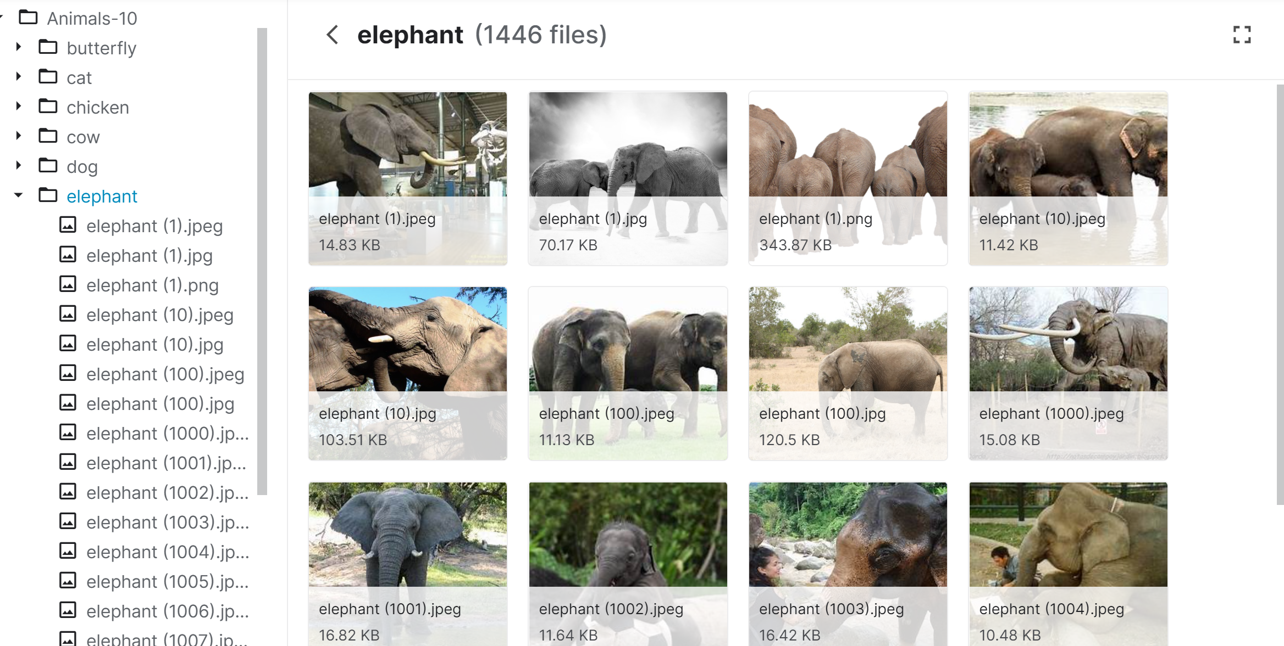
Dataset
The dataset used in this project was taken from Kaggle, and it is a collection of images of ten different animals, namely: Butterfly, cat, chicken, cow, dog, elephant, horse, sheep, spider and squirrel. The dataset contains over 1500 images of each category of animals, with a total of 26.2k files.The link to the dataset is as follows: https://www.kaggle.com/viratkothari/animal10

Slide 5
Libraries Used
1
2
3
4
5
numpy: to convert data into arrays
tensorflow: to build the model, add layers to it
opencv: for video capturing and generating frames
flask: for rendering the web page
winsound: to produce an alert sound

Slide 6
Data Preprocessing
Resizing images to dimensions of 299 x 299.
Rescaling the pixels by a value of 255.
Setting sheer range and zoom range values to 2.2.
Setting horizontal flip as true.

Slide 7
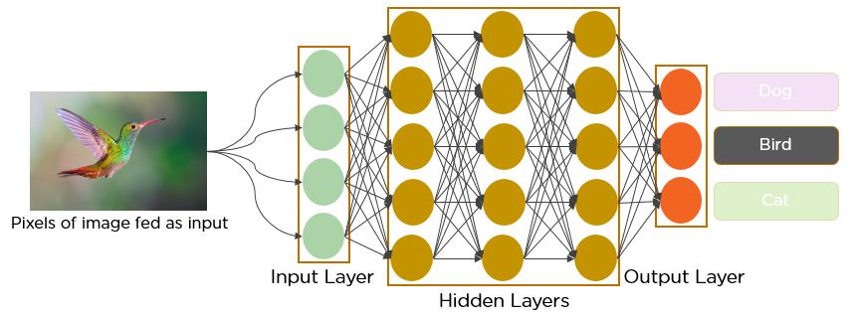
Convolutional Neural Networks
A Convolutional Neural Network (CNN) is a Deep Learning algorithm which can take in an input image, assign importance (learnable weights and biases) to various aspects/objects in the image and be able to differentiate one from the other.With enough training, CNNs have the ability to learn these filters/characteristics.
The role of the CNNs is to reduce the images into a form which is easier to process, without losing features which are critical for getting a good prediction.
In this project, CNN has been used to detect the presence of animals in a given image.

Slide 8
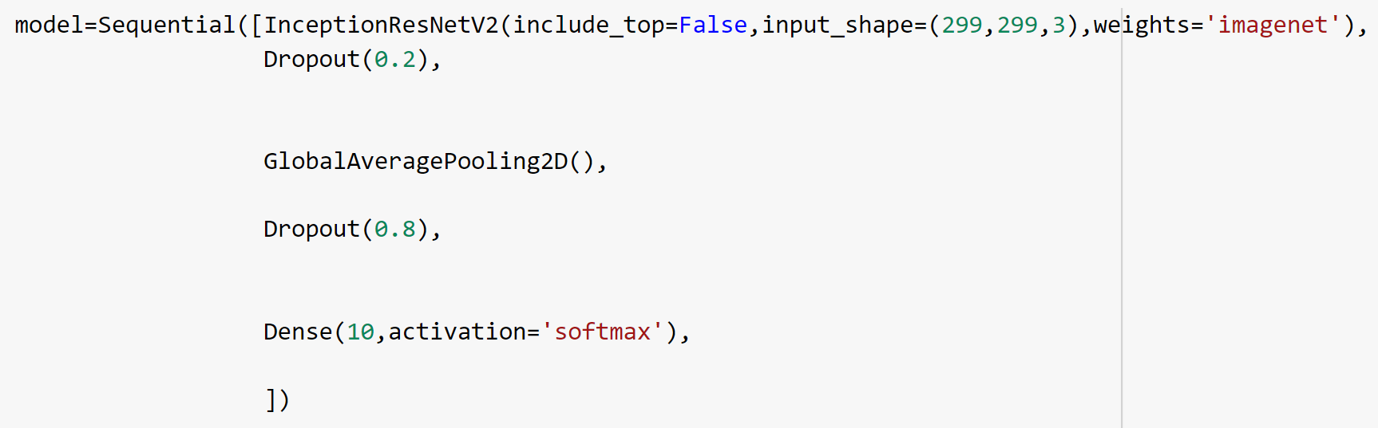
Model
70% of the contents of the dataset have been used for training the model and the remaining 30% has been used for testing. This model gave a training accuracy of 91% and a testing accuracy of 87%. It returns the indices of the classes corresponding to the ten animals.

Slide 9
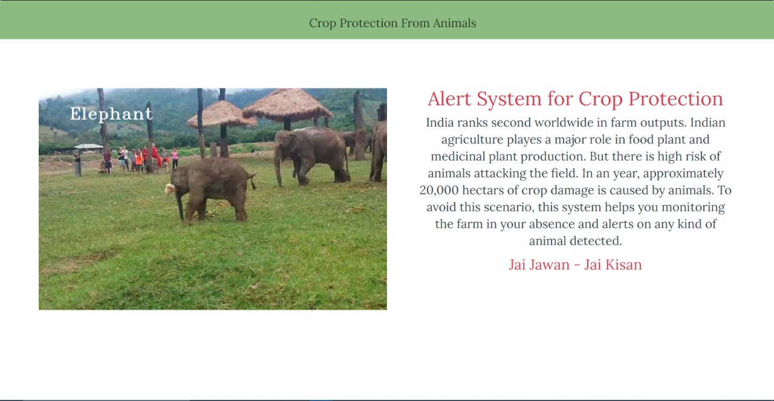
Web Application
The web application contains a video feed of the farmlands and is connected to the python backend via Flask. When an animal is captured in the video, the presence of it is detected by the CNN model and if it is an animal that can damage the crops, an alarm sound is generated.

Slide 10
Future Scope
The system could be integrated with the Cloud and a record could be maintained of the different animal intrusions, which can be used to predict the attacks based on factors such as time period where attacks are frequent, type of crops grown, fertilizers used, etc. The reach of what the system can detect can also be expanded to birds and pests.
Endangered species of animals can also intrude upon farmlands and damage crops, in cases where there are wildlife sanctuaries or national parks nearby. A collection of endangered animals can be added to the system and when such an animal is detected, an alert could be sent to the forest officials nearby, who can safely guide the animals back to their habitats.
If a certain pest infestation is prominent in the field, the system can be configured to recommend a pesticide or insecticide to the farmer on the web application. The user could input the type of crops grown so that a pesticide could be recommended which does not cause harm to the crops. Economical home remedy recipes for getting rid of pests can also be suggested.

Slide 11
Conclusion
The web application is user friendly and successfully depicts the output of the system. The detection of animals has been achieved with an accuracy of 87% and the alarm sound is sufficient to alert the farmers regarding the animal intrusion. This system is capable of efficiently protecting crops from damage by animals, while not causing harm to the animals as well.

Slide 12
THANK YOU
Insert the SubTitle of Your Presentation

